Slide 1
Organization
of
Trade

Slide 2
Channels Of Distribution
A channel of distribution or trade channel is the path or route along which goods move from producers to ultimate consumers.
It is a distribution network through which a producer puts his products in the hands of actual users.
A trade or marketing channel consists of the producer, consumers or users and the various middlemen who intervene between the two. The channel serves as a connecting link between the producer and consumers.
By bridging the gap between the point of production and the point of consumption, a channel creates time, place and possession utilities. A channel of distribution represents three types of flows:
a. Goods flow from producer to consumers;
b. Cash flow from consumers to producer as payment for goods; and
c. Marketing information flows in both directions, from producers to consumers in the form of information on new products, new uses of existing products, etc. The flow of information from consumers to producers is the feedback of the wants, suggestions, complaints, etc.

Slide 3
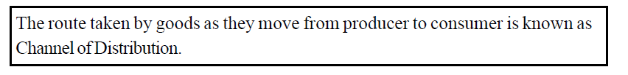
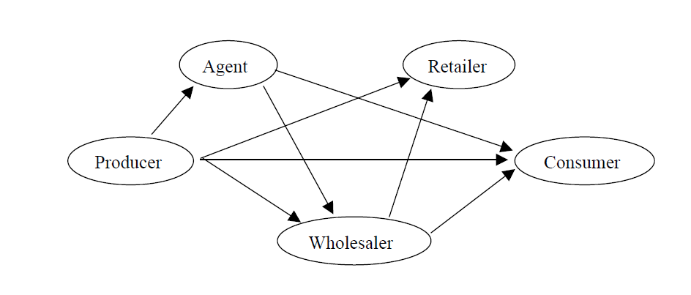

Slide 4

Functions of Channels of Distribution
Transactional Function :buying ,selling & risk bearing functions .For example intermediaries buy goods from producers, sell goods to consumers & assume risk involved in buying & selling
Logistical functions: physical exchange of goods. Assembling ,Storage ,Transportation .
Facilitating Function-like after sales service ,maintenance ,Financing & Market information about the product to buyers ,financial assistance in the form of credit sales & after sales services
Create Time Utility-by bringing the goods to the consumer when they want
Place Utility-By facilitating the movement of goods from one place to another
Convenience utility-by bringing the goods to consumer in a convenient shape ,unit ,size style & Package

Slide 5
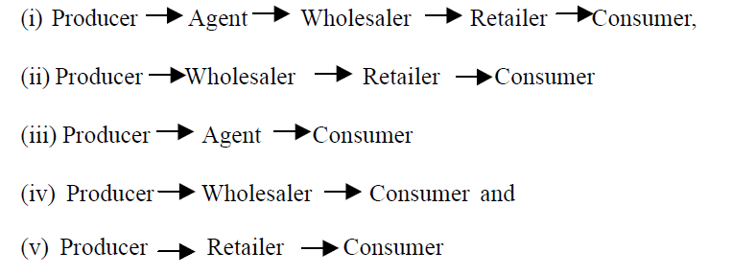
Types of Channels of Distribution

Slide 6
Direct Channel
In this channel, producers sell their goods and services directly to the consumers.
There is no middleman present between the producers and consumers. The producers may sell directly to consumers through door-to-door salesmen and through their own retail stores.
For example, Bata India Ltd, Liberty Shoes Limited has their own retail shops to sell their products to consumers. For certain service organizations consumers avail the service directly.
Banks, consultancy firms, telephone companies, passenger and freight transport services, etc. are examples of direct channel of distribution of service.

Slide 7
Indirect Channel
When a producer sells good to consumers through middlemen ,it is called Indirect Channel
If the producer is producing goods on a large scale, it may not be possible for him to sell goods directly to consumers. As such, he sells goods through middlemen.
These middlemen may be wholesalers or retailers. A wholesaler is a person who buys goods in large quantities from producers; where as a retailer is one who buys goods from wholesalers and producers and sells to ultimate consumers as per their requirement.
the involvement of various middlemen in the process of distribution constitute the indirect channel of distribution.

Slide 8

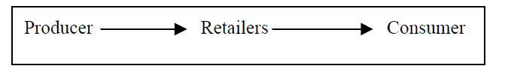
Types of Indirect Channels of Distribution
This is the common channel for the distribution of goods to ultimate consumers. Selling goods through wholesaler may be suitable in case of food grains, spices, utensils, etc. and mostly of items, which are smaller in size
Under this channel, the producers sell to one or more retailers who in turn sell to the ultimate consumers. This channel is used under the following conditions –
(i) When the goods cater to a local market, for example, breads, biscuits, patties, etc.
(ii) When the retailers are big and buy in bulk but sell in smaller units, directly to the consumers.
Departmental stores and super bazars are examples of this channel.

Slide 9
Importance of Channels of distribution
Cost Savings in Specialization - Members of the distribution channel are specialists in what they do and can often perform tasks better and at lower cost than companies who do not have distribution experience. · Reduce Exchange Time - Not only are channel members able to reduce distribution costs by being experienced at what they do, they often perform their job more rapidly resulting in faster product delivery.
Customers Want to Conveniently Shop for Variety - Marketers have to understand what customers want in their shopping experience .Resellers within the channel of distribution serve two very important needs:
1) they give customers the products they want by purchasing from many suppliers, and
2) they make it convenient to purchase by making products available in single location.

Slide 10
Resellers Sell Smaller Quantities -They allow customers to purchase in quantities that work for them. Suppliers though like to ship products they produce in large quantities since this is more cost effective
Create Sales - Resellers are at the front line when it comes to creating demand for the marketer's product. In some cases resellers perform an active selling role using persuasive techniques to encourage customers to purchase a marketer's product. In other cases they encourage sales of the product through their own advertising efforts and using other promotional means such as special product displays.
Offer Financial Support - Resellers often provide programs that enable customers to more easily purchase products by offering financial programs that ease payment requirements. These programs include allowing customers to: purchase on credit; purchase using a payment plan;; and allowing exchange options.

Slide 11
Factors or considerations affecting the choice of a distribution channel
Type of product
For Perishable products (eggs ,milk ,butter etc) -Short channels which facilitate quick movement from factory to consumers
For heavy & bulky (steel ,cement)-Limited channels
For light weight & small size items (Soap,Matchsticks,tooothpastes,hairoils etc)-Long Channels for intensive distribution
Nature & extent of Market
If number of customer is large –Long & multiple channels for intensive distribution
If no of customer I small-Short & direct channels
Buying Habits of the customer
If customers purchase small quantities –Long & Multiple channels
If Customers purchase large quantities –Short & direct Channels
No of suppliers of the product
No Of suppliers Large in different regions –Long & Multiple channels
No Of suppliers small-Short & Direct Channels

Slide 12
Internal Trade
Internal Trade or Home trade refers to buying & selling of goods & services within a country .
The main features of internal Trade are :
Buying & selling of goods & services takes place within the boundaries of the same country
Trade payments are made & received in the same home currency of the country
Several modes of payment such as cash ,cheque ,draft ,pay order etc are available
Several modes of transportation are available such as Rickshaw ,truck ,rail ,air etc are available

Slide 13
Classification of Internal Trade
Whole sale Trade :refers to buying & selling of goods in bulk from manufacture or their agents & selling them to retailers & industrial users in small quantity .Those who are engaged in wholesale trade are called wholesalers
Retail Trade :refers to buying & selling of goods from wholesalers or manufacturers & selling them directly to the ultimate consumers & those who are engaged in retail trade are called retailers

Slide 14
Characteristics of Wholesalers
(i) Wholesalers buy goods directly from producers or manufacturers.
(ii) Wholesalers buy goods in large quantities and sells in relatively smaller quantities.
(iii) They sell different varieties of a particular line of product. For example, a wholesaler who deals with paper is expected to keep all varieties of paper, cardboard, card, etc.
(iv) They may employ a number of agents or workers for distribution of products.
(v) Wholesalers need large amount of capital to be invested in his business.
(vi) They generally provides credit facility to retailers.
(vii) He also provides financial assistance to the producers or manufacturers.
(viii) In a city or town they are normally seen to be located in one particular area of the market.
For example, you can find cloth merchants in one area, book publishers and sellers in one area; furniture dealers in one area etc.

Slide 15
Types of wholesalers
Manufacture Wholesaler –Are those who manufacture goods as well as sell the goods to retailers. They generally do not deal in goods of other manufactures .they are able to reduce the distribution & warehousing cost & increase their margin to that extent
Retailer Wholesaler-- are those wholesalers who sell goods to retailers but also to ultimate consumers & they are able to get prompt & first hand information relating to the product directly from ultimate consumers. They are also able to reduce the distribution cost & increase their margin to that extent
.
Pure whole sellers- are those who buy good is bulk from manufacture s of goods & sells the goods only to retailers relatively in small quantities. They neither produce the goods nor sell the goods directly to the ultimate consumers. They are able to serve the manufactures & Retailers

Slide 16
Functions of Wholesalers
(a) Collection of goods: A wholesaler collects goods from manufacturers or producers in large quantities.
(b) Storage of goods: A wholesaler collects the goods and stores them safely in warehouses ,till they are sold out. Perishable goods like fruits, vegetables, etc. are stored in cold storage.
(c) Distribution: A wholesaler sells goods to different retailers. In this way, he also performs the function of distribution.
(d) Financing: The wholesaler provides financial support to producers and manufacturers by sending money in advance to them. He also sells goods to the retailer on credit. Thus, at both ends the wholesaler acts as a financier.
(e) Risk taking: The wholesaler buys finished goods from the producer and keeps them in the warehouses till they are sold. Therefore, he assumes the risks arising out of changes in demand, rise in price, spoilage or destruction of goods.

Slide 17
Characteristics of Retailers
Retailers are the traders who buy goods from wholesalers or sometimes directly from producers and sell them to the consumers. They usually operate through a retail shop and sell goods in small quantities. They keep a variety of items of daily use. The following are the characteristics of retailers:
(i) Retailers have a direct contact with consumers. They know the requirements of the consumers and keep goods accordingly in their shops.
(ii) Retailers sell goods not for resale, but for ultimate use by consumers. For example, you buy fruits, clothes, pen, pencil etc. for your use, not for sale.
(iii) Retailers buy and sell goods in small quantities. So customers can fulfil their requirement without storing much for the future.
(iv) Retailers require less capital to start and run the business as compared to wholesalers.
(v) Retailers generally deal with different varieties of products and they give a wide choice to the consumers to buy the goods.

Slide 18
Types of Retailers
Itinerant Retailers –Are those who keep on moving from place to place to sell their goods .They do not have any fixed place of business. They deal in Low priced consumer goods of regular use like –toys, bangles ,Household utensils .
Hawkers & peddlers –Ice-cream, bangles, Fruits ,vegetable
Market Traders-Stalls at a Mela or Fairs , Or fixed Bazaars on certain fixed days
Street Traders/Pavement Traders-Newspapers, Footwear ,Stationery
Fixed shop Retailers
1)Small Scale retailers :are those fixed shop retailers who carry on their business on a small scale & sell the good sin small quantities They hold stock & carry on their business in fixed shops located in residential area or market place General Stores-They deal in different kinds of consumer goods
Single Line stores –Deal in particular line of product(Ready made Garments-children ,Men ,ladies)
Specialty stores –Specializes in single type of product (Children Garments only ,Educational Books only )
Street shops/Street Stalls –Low priced articles- Pens, Magazines etc

Slide 19
2)Large Scale Retailers –Are those fixed shops retailers who carry on their business on a large scale & sell the goods in small quantities. They hold large stocks of variety of goods
Departmental Stores-Retail store in which wide variety of products are sold through separate departments under one roof
Multiple Shops or Chain stores-retail shops owned & controlled by a single organization & located in different parts of the city which deals in similar product at uniform
Mail order Business-in this business transactions are made through postal communication & delivery of goods by parcel
Consumer Cooperatives-retail stores run by cooperative societies

Slide 20
Functions of Retailers
All retailers deal with the customers of varying tastes and temperaments. Therefore, they should be active and efficient in order to satisfy their customers and also to induce them to buy more. Let us see what the retailers do in distribution of goods.
(i) Buying and Assembling of goods: Retailers buy and assemble varieties of goods from different wholesalers and manufacturers. They keep goods of those brands and variety which are liked by the customers and the quantity in which these are in demand.
(ii) Storage of goods: To ensure ready supply of goods to the customer retailers keep their goods in stores. Goods can be taken out of these store and sold to the customers as and when required. This saves consumers from botheration of buying goods in bulk and storing them.
(iii) Credit facility: Although retailers mostly sell goods for cash, they also supply goods on credit to their regular customers. Credit facility is also provided to those customers who buy goods in large quantity.

Slide 21
iv) Personal services: Retailers render personal services to the customers by providing expert advice regarding quality, features and usefulness of the items. They give suggestions considering the likes and dislikes of the customers. They also provide free home delivery service to customers. Thus, they create place utility by making the goods available when they are demanded.
(v) Risk bearing: The retailer has to bear many risks, such as risk of:
(a) fire or theft of goods
(b) deterioration in the quality of goods as long as they are not sold out.
(c) change in fashion and taste of consumers.
(vi) Display of goods: Retailers display different types of goods in a very systematic and attractive manner. It helps to attract the attention of the customers and also facilitates quick delivery of goods.
(vii) Supply of information: Retailers provide all information about the behavior, tastes, fashions and demands of the customers to the producers through wholesalers. They become a very useful source of information for marketing research

Slide 22
External Trade
External Trade refers to buying & selling of goods & services between the nationals of different countries or trade between agencies of the government of different countries .It is also known as foreign trade or international Trade .It consist of Export trade & Import trade and entreport trade
Export Trade :It involves the selling of goods & services to other countries .For example when M/s PP Jewelers ,an Indian firm ,Exports gold plain jewellery to USA ,they are said to be involved in export trade
Import Trade :It Involves the purchasing of goods & services from other countries .For example ,when M/s Ratna Sagar ,An Indian publisher ,imports books from Frankfurt <they are said to be involved in import Trade .
Entreport Trade :It involves importing of goods from one or more countries with the purpose of exporting them to some other country or countries .For Example When M?s pustak MaHal ,an Indian publisher imports some books to USA .For the purpose of exporting them to Nepal they are said to be involved in Entreport Trade
Notes:
Singapore ,Hongkong,korea are important entrport trade centre

Slide 23
Difference Between External Trade & Internal Trade
Basis | Home Trade | Foreign Trade
Where it takes place | Within the country | Beyond the national boundaries
People Involved | Citizens in the same country | Citizens of two or more country
Restrictions | Little | Many
Currency to be used | Home Currency | Foreign currency acceptable to the exporter
Mode of Payment | In Cash or cheque | Only Through bank

Slide 24
Support Services to Business
The business support services refer to those business activities that act as auxiliaries to trade and facilitate smooth flow of goods from producer to consumer and the functioning of business as such
These include banking, insurance, transportation, warehousing and communication.
Banking helps in providing finance and payment facilities, insurance to provide a cover to all sorts of business risks,
transportation to facilitate physical movement of goods from one place to another
warehousing to provide storage facilities at various places to meet seasonal variations in demand,
and communication for facilitating exchange of information and ideas between producers, middlemen and consumers.
Thus, effectively, these business services are essential for smooth functioning of any business in any part of the world, and every person who is engaged in business must be fully aware of their functioning and use

Slide 25
Transportation
(a)Transport plays a very important role in distribution of goods both within a country and across the borders.
(b) Transport helps in bringing about stable and uniform prices in different markets as traders are able to adjust the supply of goods at different places according to the changing demand.
(c) Consumers have the benefit of getting goods at their door step and have a wider choice of goods at competitive prices.
(d) It ensures continuous supply of raw materials to the industry.

Slide 26
(e) It contributes to growth of large scale industries by facilitating the inflow of materials and outflow of finished goods.
(f) International competition is encouraged with the improved transport system. This makes global markets accessible to sellers and buyers of different countries.

Slide 27
Insurance
(a) Protection Against Risk: Insurance provides protection against various risks involved in business. The protection is in the form of a provision to compensate for the loss suffered by the insured.
(b) Pooling of Risk: Insurance helps in sharing of risk. In practice, a large number of people seek insurance by paying the premium which results in the formation of insurance fund. This fund is used for compensating a few among them who may suffer a loss. Thus, in effect the loss is spread over a large number of people.
(c) Helps in Securing Loans: Banks and financial institutions usually insist on the insurance of goods and properties before loans can be sanctioned on their security. So insurance makes it convenient to secure loans and advances from the financial institutions.

Slide 28
Insurance
(d) Protection Against Liabilities under various Labour Laws: Insurance gives protection to businessmen in the event of compensation payable to employees for accidents leading to fatal injury, partial injury, disablement, as well as sickness and maternity.
(e) Contribute to Economic Development: Funds with the insurance companies are invested in various types of securities and projects, which contribute to economic development of the country.
(f) Generation of Employment: Insurance companies provide employment to a large number of people on regular basis. A number of people earn their livelihood working as insurance agents.
(g) Social Security: Life insurance provides security against risks of old age and premature death of people. Besides, social security is provided to workers through the Employees State Insurance scheme whereby accidental risks are covered.

Slide 29
WAREHOUSING
warehousing bridges the time gap between production of goods and
their consumption, and thus, serves useful purpose particularly for large-scale business operations. Based on its uses, its importance can be briefly described as follows.
(a) Storage of Raw Materials: To maintain continuity in production, a good quantity of raw materials is to be kept in stock. Not only that, some raw materials are only available in specific period of the year (cotton, oilseeds etc.) while these are used for production throughout the year. So, these have to be kept in stock for use as and when required.
(b) Storage in Anticipation of Rise in Price: In case the manufacturer anticipates a rise in prices of raw materials in future he/she likes to purchase it in advance and stock it. It equally applies to traders of goods if they expect price rise.
.

Slide 30
(c) Storage of Finished Goods: Since goods are generally produced in anticipation of demand, these need to be stored till sales take place. Not only that, some goods are produced round the year but purchased/used during a specified part of the year e.g. electric fans, woollen clothes. Similarly, some goods may be produced during a part of the year but used throughout the year like sugar.
(d) Storage of Goods by the Wholesalers: Wholesalers buy goods in bulk and maintain stock of goods in warehouses for sale in small quantities to retailers from time to time.
(e) Use for Importers: Warehouses (known as bonded warehouse) are used for storage of imported goods till the importer is able to pay the customs duty and take delivery.
Based on the above uses of warehousing, it can be concluded that it is an important link in the chain of marketing and adds to the time and place value of goods. It also smoothens out fluctuations in their supply and demand. So, wherever there is trade and commerce , there is need for warehousing.

Slide 31
Banking
(a) Capital Formation: Deposits accepted by banks are channelized as loans and advances for industrial and trading activities to business organizations. Thus, banking indirectly converts savings into investment leading to capital formation and development of economy.
(b) Services to Business: Banking helps business through a variety of services such as providing long-term and short-term finance, arranging remittance of money, collection of cheques and bills etc., assisting in raising of capital by acting as underwriters and merchant bankers and so on.
(c) Reduces Use of Currency: Banks enable depositors to make payment by cheque, which is transferable by endorsement and delivery. Besides, travellers can carry travellers’ cheques, credit cards etc. issued by banks instead of liquid money. Thus , use of currency is considerably reduced.

Slide 32
(d) Mobilisation of Savings: Banks allow savings to be deposited in different types of accounts such as Current Account, Savings Bank Account, Fixed Deposit Account,etc. The facilities of withdrawal as and when desired, and payment of interest on deposits encourage people to save money and put it in the banks.
(e) Benefits to Rural Economy: Rural branches of banks play a useful role in mobilising savings in rural areas and provide loans to farmers and artisans at concessional rates and on priority basis. This helps the rural economy in a big way.
(f) Balanced Development of Economy: Banks identify areas that need special assistance for industrial development and provide them the necessary help. Similarly they also identify backward regions and help in their economic development by providing them adequate funds at reasonable rates. Banks thus, help backward areasin industry and balanced regional development.

Slide 33
Franchise businesses
A franchise business is a business in which the owners, or franchisers, sell the rights to their business logo and model to third parties, called franchisees
Franchising is a way for small business owners to benefit from the economies of scale of the big corporation (franchiser).
McDonald's restaurants, Subway etc are examples of a franchise.
The small business owner can leverage a strong brand name and purchasing power of the larger company while keeping their own investment affordable.

Slide 34
Investing in a Franchise Business
To invest in a franchise, the franchisee must first pay an initial fee for the rights to the business, training, and the equipment required by that particular franchise.
Thereafter, the franchisee will generally pay the franchise business owner an ongoing royalty payment, either on a monthly or quarterly basis. This payment is usually calculated as a percentage of the franchise operation’s gross sales.
After the contract has been signed, the franchisee will open a replica of the franchise business, under the direction of the franchiser. The franchisee will not have as much control over the business as he or she would over their own, but may benefit from investing in an already-established brand.

Slide 35
Benefits in Franchise Business to Franchisee
The franchisee is given support by the franchiser in respect of marketing &staff training
The franchisee may benefit from national advertising and being part of a well-known organization with an established name ,format & product
A franchise allows people to start & run their own business with less risk .thee chance of failure among new franchises is minimal as their product is a proven success and has a secure place in market
The franchisees usually need less capital than they would if they were setting up a business independently because the franchisor ,through their pilot operations and buying power ,would have eliminated unnecessary expenses
The franchisee has the benefit of the franchisor's continuous research and development programmes ,which are designed to improve the business and keeps in up-to date and competitive

Slide 36
Disadvantages in Franchise Business to Franchisee
The franchisee has less independence than a sole trader .He may feel more like a manger than an owner
He is required to make payments of royalties
He may not be able to sell the business without the franchisor’s approval

Slide 37
Business Process Outsourcing
BPO is the process of hiring another company to handle business activities for you.
Outsourced services include manufacturing, software development, web development, finance, accounting, human resources and customer service, among others
Now it is common for organizations to outsource financial and administration (F&A) processes, human resources (HR) functions, call center and customer service activities and accounting and payroll.
Many of these BPO efforts involve offshoring -- hiring a company based in another country to do the work. India is a popular location for BPO activities.

Slide 38
Business Process Outsourcing-Benefits
Cost reductions- Cost reduction is done through process improvements, reengineering and use of technologies that reduce and bring administrative and other costs under control.
Concentration on core business- With the day-to-day back office operations taken care of, the management is free to concentrate more on the core business of the company.
Outside expertise- Company is saved from the hassles of recruiting and training personnel. BPOs ensure that experts from another company provide the needed guidance and skills.

Slide 39
Cater to changing customer demands- It is another great advantage of out sourcing the business processes. Many BPOs provide the management with flexible and scalable services to meet the customers' changing requirements, and to support company acquisitions, consolidations, and joint ventures.
Revenue increase- As stated above, by outsourcing non-core processes, companies can concentrate on increasing their sales and market share, develop new products; spread out into new markets and increase customer service and satisfaction

Slide 40
India’s advantages as the BPO destination:
India is providing one of the largest platforms of low-cost English speaking highly educated, scientifically and technically skilled work force. This makes India one of the obvious choices for BPO services. Thus India’s advantages to outsource can be summarized as follows:-
Availability of qualified personnel across various industrial fields.
English speaking and IT savvy workforce providing a suitable platform for an outsourced call center.
Indians are taking BPO jobs as a good career option.
Vital government support for Call center & BPO services providing industry.
Cost reduction up to 50%.

Slide 41
Telecom infrastructure is improving to meet outsourced call center requirements.
Infrastructure costs are low in comparison to other countries.
Adherence to leading quality practices by various organizations and important aspect is certifications are given importance.
Strong domestic IT services industries are coming up to support BPO industry.

Slide 42
Business Process Outsourcing
BPO helps companies to focus on core areas. Companies generally outsource processes to reallocate accountability and control costs. Thus the management is in a better position to focus on core areas, and not keep itself engrossed in other areas.
Outsourcing also helps companies to avoid capital expenditures, which is in particular important in non-core areas that may need new systems and up gradation. By and large, companies only want to spend money on core areas. Reduction in costs is another BPO benefit.
BPO provides quantifiable benefits through improved efficiencies, lower overhead, reduced payroll and benefit expenses, and fewer capital investments.
Other BPO benefits include assurance of best practices, skills, and technology. It is important to note that BPO provides access to proprietary workflow systems, process reengineering skills, and innovative staffing and delivery models, coupled with world-class technology delivered by experts.

Slide 43
Multinationals Companies –Meaning
A multinational company is a huge industrial organization which-
Operates in more than one country
Carries out production ,marketing & research activities on international scale in those countries
Attempts to maximize profits world over
a multi-national company is one which is registered as a company in one country but carries on business in a number of other countries by setting up factories, branches or subsidiary units.
Such a company may produce goods or arrange services in one or more countries and sell these in the same or other countries
Multinational Companies (MNCs) running business in India-Philips, Siemens, Hyundai, Coca Cola, Nestle, Sony, McDonald’s, Citi Bank, etc.

Slide 44
Features of Multinational Companies
(i) International Operations: Multinational Companies generally have production, marketing and other facilities in several countries.
(ii) Large size: The volume of sales, the profits earned, and also the value of assets held by a multinational companies are generally very large.
(iii) Centralised Control: The branches and subsidiary units of an MNC operating in different countries are controlled from the headquarters of the company in the home country, which lay down broad policies to be pursued.

Slide 45
Advantages of Multinational Companies
i)Investment of Foreign capital: Direct investment of capital by MNC’s helps under-developed countries to speed up their economic development.
(ii) Generation of employment: Expansion of industrial and trading activities by MNC leads to creation of employment opportunities and raising the standard of living in host countries.
(iii) Use of advanced technology: With substantial resources MNC undertake Research & Development activities which contribute to improved methods and processes of production and thus, increase the quality of products. Gradually, other countries also acquire these technologies.
(iv) Growth of ancillary units: Suppliers of materials & services & ancillary industries often grow in host countries as a result of the operation of MNC
.

Slide 46
(v) Increase in exports and inflow of foreign exchange: Goods produced in the host countries are sometimes exported by MNC’s. Foreign exchange thus earned contributes to the foreign exchange reserves of host countries.
(vi) Healthy competition: Efficient production of quality goods by multinational companies prompt the domestic producers to improve their performance in order to survive in the market

Slide 47
Limitations of Multinational Companies
The advantages discussed above are no doubt beneficial to host countries. But there are several limitations of multinational companies, which we should take note of:
i. Least concern for priorities of host countries: Multinational Companies generally invest capital in the most profitable industries and do not take into account the priorities of developing basic industries and services in backward regions of the host country.
ii. Adverse effect on domestic enterprises: Due to large-scale operation and technological skills, multinational companies are often able to dominate the markets in host countries and tend to acquire monopoly power. Thus, many local enterprises are compelled to close down.
iii. Change in tradition: Consumer goods, which are introduced by multinational companies in the host countries, do not generally conform to the local cultural norms. Thus, consumption habits of people as regards food and dress tend to change away from their own cultural heritage.

Slide 48
Role of MNC’s
Multinational corporations (MNCs) are huge industrial organizations having a wide network of branches and subsidiaries spread over a number of countries.
The two main characteristics of MNCs are their large size and the fact that their worldwide activities are centrally controlled by the parent companies. Such a company may enter into joint venture with a company in another country. There may be agreement among companies of different countries in respect of division of production, market, etc.
MNCs have great impact on the development process of the Underdeveloped countries.

Slide 49
Business Combinations
A business combination is an assembly of two or more groups of firms ,or concerns engaged in the production and distribution of commodities in the national or international markets with two main objects :
Elimination of unhealthy competition
Avoidance of wasteful expenditure in production & distribution or marketing policies .
Business combinations are transactions in which one entity gains control, or at least controlling interest, in another entity.
Agglomeration of the assets of two or more firms for their consolidation as one entity under single ownership
Forms of Business Combinations
Mergers-
Amalgamation
Acquisitions

Slide 50
Merger
It is a situation where 2 or more existing firms combine to form new entity. Either a new firm is formed or a smaller firm is formed is merged into a bigger firm.
The combination of two firms into a new legal entity

Slide 51
Types of Merger
Horizontal Merger
Vertical Merger
Conglomerate Merger
Concentric Merger

Slide 52
Horizontal Merger
Horizontal mergers are those mergers where the companies manufacturing similar kinds of commodities or running similar type of businesses merge with each other.
Lipton India and Brooke Bond.
Bank of Mathura with ICICI Bank.

Slide 53
Vertical Merger
A merger between two companies producing different goods or services.

Slide 54
Conglomerate Merger
A merger between firms that are involved in totally unrelated business activities.
Two types of conglomerate mergers:
Pure conglomerate mergers involve firms with nothing in common.
2. Mixed conglomerate mergers involve firms that are looking for product extensions or market extensions.

Slide 55
Concentric Merger
A merger of firms which are into similar type of business.

Slide 56
Acquisition & Takeover

Slide 57
ACQUISITION
A transaction where one firms buys another firm with the intent of more effectively using a core competence by making the acquired firm a subsidiary within its portfolio of business
It also known as a takeover or a buyout
It is the buying of one company by another.
In acquisition two companies are combine together to form a new company altogether.
Example: Company A+ Company B= Company A.

Slide 58
ACQUISITION:WHY & WHY NOT
WHY IS IMPORTANT
PROBLEM WITH ACUIQISITION
Increased market share.
Increased speed to market
Lower risk comparing to develop new products.
Increased diversification
Avoid excessive competition
Inadequate valuation of target.
Inability to achieve synergy.
Finance by taking huge debt.

Slide 59
Takeovers
A corporate action where an acquiring company makes a bid for an acquiree. If the target company is publicly traded, the acquiring company will make an offer for the outstanding shares.

Slide 60
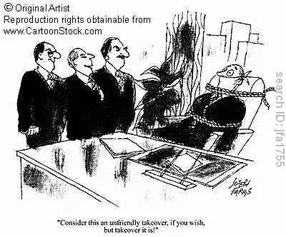
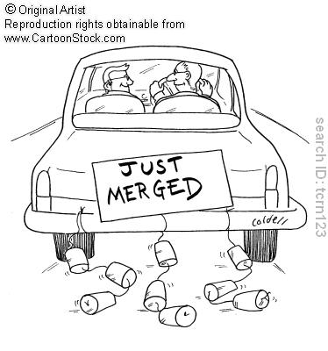
Takeover might be :
Hostile Takeover
A takeover attempt that is strongly resisted by the target firm
Friendly Takeover
Target company's management and board of directors agree to a merger or acquisition by another company.

Slide 61
WHY SHOULD FIRMS TAKEOVER?
To gain opportunities of market growth more quickly than through internal means
To seek to gain benefits from economies of scale
To seek to gain a more dominant position in a national or global market
To acquire the skills or strengths of another firm to complement the existing business
To acquire a speedy access to revenue streams that it would be difficult to build through normal internal growth
To diversify its product or service range to protect itself against downturns in its core markets

Slide 62
DIFFERENCE BETWEEN MERGER AND ACQUISITION:
MERGER
ACQUISITION
Merging of two organization in to one.
It is the mutual decision.
Merger is expensive than acquisition(higher legal cost).
It is time consuming and the company has to maintain so much legal issues.
Dilution of ownership occurs in merger.
Buying one organization by another.
It can be friendly takeover or hostile takeover.
Acquisition is less expensive than merger.
It is faster and easier transaction.
The acquirer does not experience the dilution of ownership.

